Slide 1
Chapter 2: Introduction to Object-Oriented Systems Analysis and Design with the Unified Modeling Language, Version 2.0
Systems Analysis and Design with UML 2.0:
An Object-Oriented Approach, Second Edition
Robert Barker
Spring 2007

Slide 2
Discussion Topics
Review the basic characteristics of object-oriented systems
Introduce the Unified Modeling Language (UML), Version 2.0
Introduce the Unified Process (UP)

Slide 3
Basic Characteristics of Object Oriented Systems
Classes and Objects
Methods and Messages
Encapsulation
Inheritance
Polymorphism

Slide 4
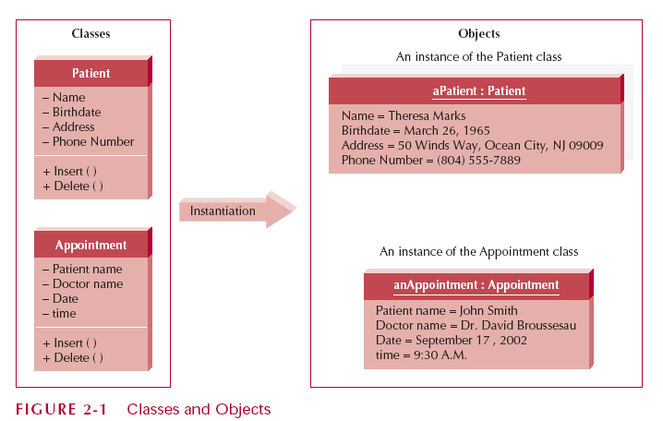
Classes and Objects

Slide 5
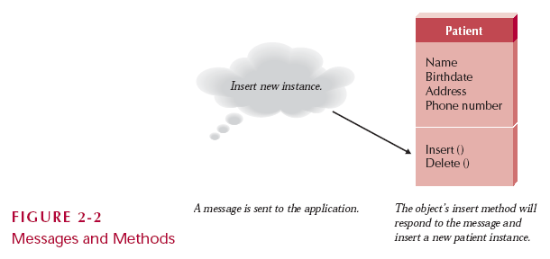
Messages and Methods

Slide 6
Encapsulation
Encapsulation
  Combining data and process into an entity
Information Hiding
  Only the information required to use a software module is published to the user; i.e., its public interface
Reusability
  Re-use an object by calling the methods in its public interface

Slide 7
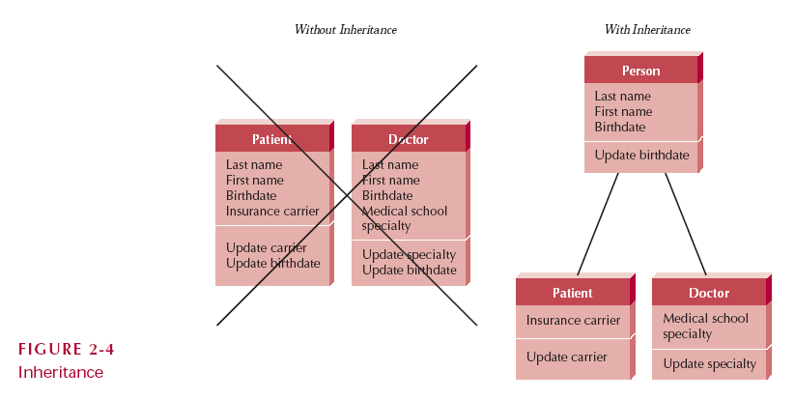
Inheritance

Slide 8
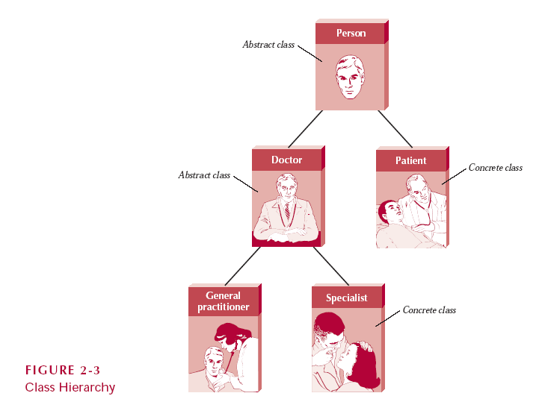
Inheritance – Class Hierarchy

Slide 9
Polymorphism
Polymorphism
  A message can be interpreted differently by different classes of objects
Dynamic Binding
  Sometimes called late binding
  Delays typing or choosing a method for an object until run-time
Static Binding
  Type of object determined at compile time

Slide 10
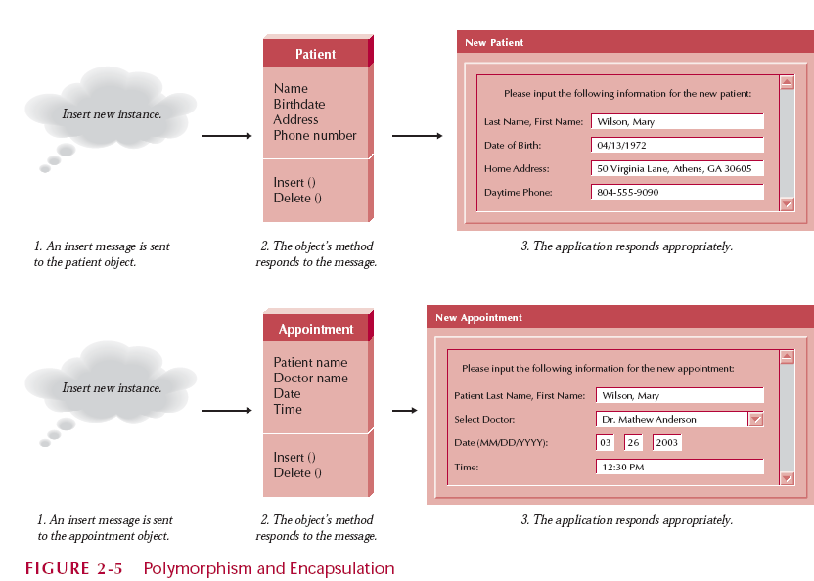
Polymorphism & Encapsulation

Slide 11
The Unified Modeling Language, Version 2.0
Developers
  Grady Booch
  Ivar Jacobson
  James Rumbaugh
UML is a modeling tool; it is not a systems development methodology
Structure Diagrams
Behavior Diagrams

Slide 12
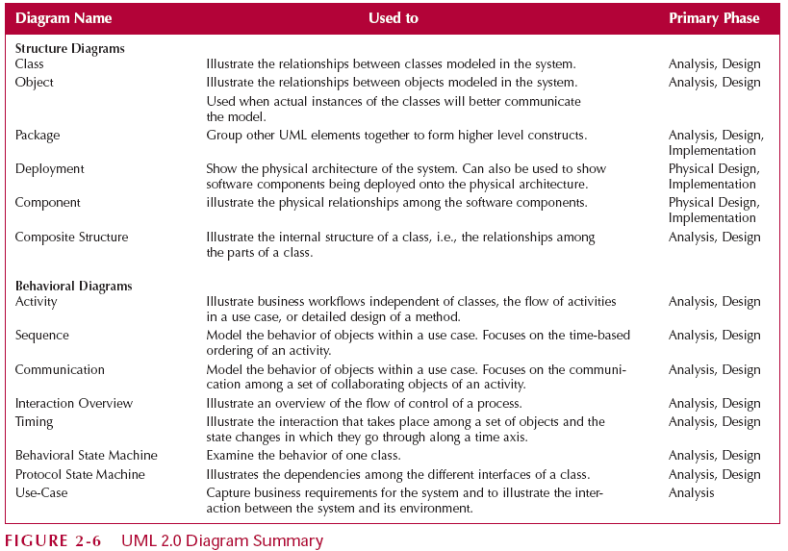
UML 2.0 Diagram Summary

Slide 13
The Unified Process
Use-case driven
Architecture Centric
Iterative and Incremental

Slide 14
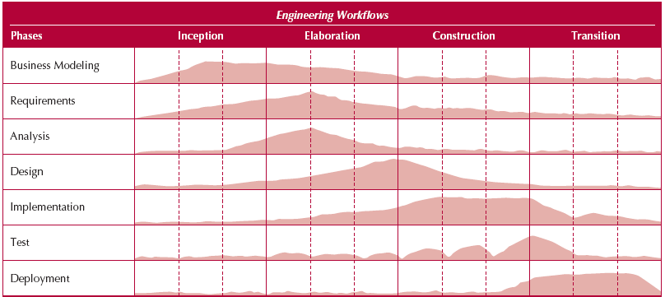
Engineering Workflows

Slide 15
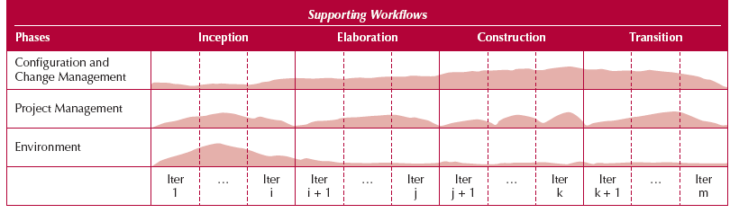
Supporting Workflows

Slide 16
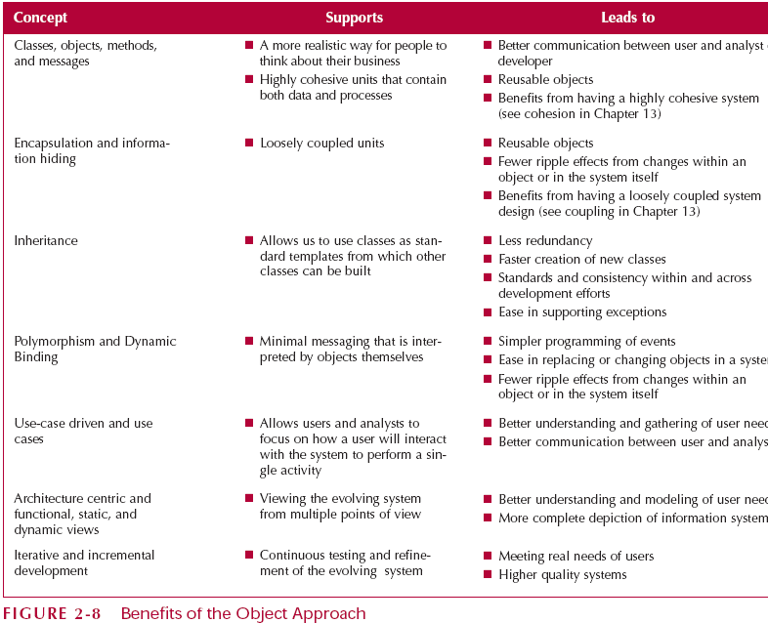
Benefits of the Object Approach

Slide 17
Questions
Should programming languages influence the methods used to model the system; i.e., the systems development methodology?
Why does this course use UML?
Why does this course follow the UP?

